Slide 1
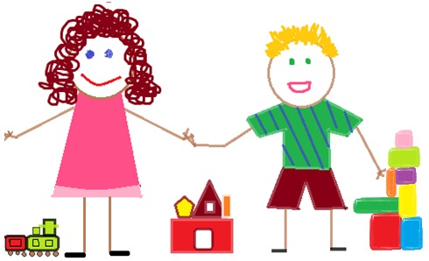
Module 2: Child Growth and Development
Power point 2

Slide 2
Objective
The student will identify the developmental needs of infants, toddlers, preschoolers, and school-agers to age eight.

Slide 3
Discussion Questions
What do all young children need in order to thrive.
What are the specific needs of each stage
What are individual differences in needs

Slide 4
Developmental and Individual Needs
Research tells us that:
Learning starts with families and in communities.
Children learn through relationships, play, and active exploration.
Every child and family has unique gifts and abilities.
Children learn best when they are healthy, safe, and free of hunger
Learning is interrelated and builds upon prior learning and development.
Young children can learn more than one language.
Building “executive function” (the command and control center of the brain) is crucial for development and learning.
Children learn in and through their environment.

Slide 5

Developmental and Individual Needs contd.
Research contd.
Learning is interrelated and builds upon prior learning and development.
Young children can learn more than one language.
Building “executive function” (the command and control center of the brain) is crucial for development and learning.
Children learn in and through their environment.

Slide 6
These are the Developmentally Appropriate Practices or DAP
Knowledge of child development and learning helps us decide which experiences are best for children at specific times in their lives.
2. We learn about each child’s interests, abilities,
and progress when we continually observe a
child’s play and interaction.

Slide 7
These are the Developmentally Appropriate Practices or DAP
By getting to know the children’s families and learning about the values, expectations, and factors that shape their lives at home and in their communities, we will be able to provide meaningful, relevant and respectful learning experiences for each child.

Slide 8

Temperament
Research says...each child is born with his/her own temperament and behavioral characteristics that usually persist through life.

Slide 9
Nine Temperamental Traits:
Activity level
Regularity of sleeping and eating patterns
Adaptability (approach to or withdrawal from new situations)
Intensity of emotion
Mood (generally positive or negative)
Distractibility (high or low)
Persistence
Attention span
Sensory sensitivity

Slide 10

Think about this...
The term “Goodness of Fit” is the match between a child’s temperament and his or her environment. A child is in good fit when adult expectations and demands match the child’s temperamental characteristics.
Caregivers need to model respect for and support of each child’s unique combination of genetics, culture, temperament and experiences.

